Slide 1


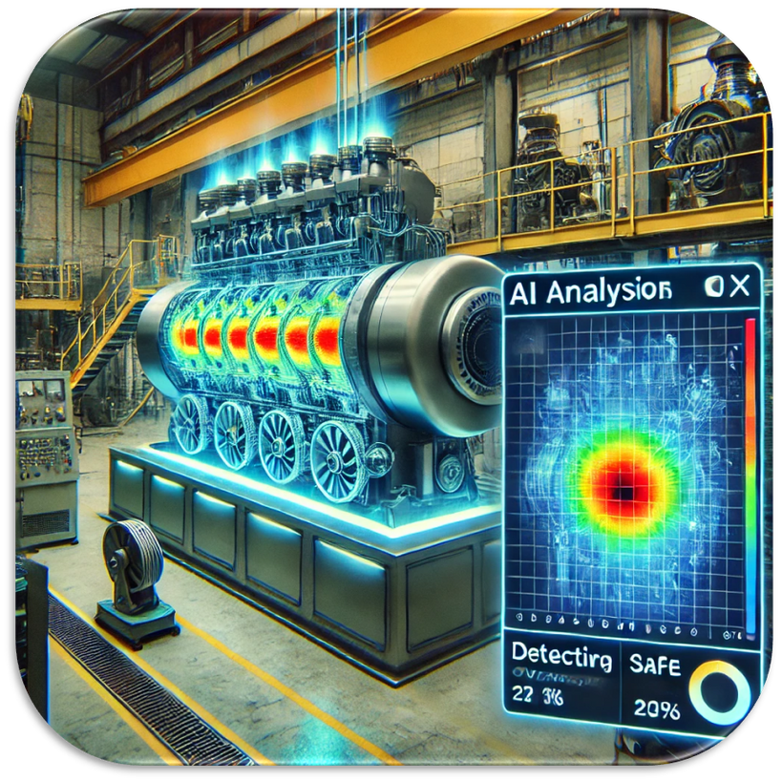
University College of Engineering, Nagercoil,
EC3811-ProjectWork/Internship
Internship at Vi Microsystems Pvt,Ltd.,Nagercoil
INDUSTRIAL MACHINE DEFECT DETECTION USING AI
Mentor:
Dr.Bharathi,Assistant Professor
ECE Department,UCEN
PRESENTED BY:
ABHIRAMI.M-962821106001
ECE-Final Year

Slide 2
ABSTRACT
This project proposes an AI-based industrial machine defect detection system using ESP32 microcontrollers and Edge Impulse. A transmitter ESP32 with a microswitch sends a signal via ESP-NOW to a receiver ESP32, which activates a relay to start the motor. The receiver block includes a voltage divider circuit to monitor the motor's voltage, an ACS712 sensor to measure current, and an I2S microphone to capture the motor’s sound. The captured audio is analyzed using a machine learning model trained with Edge Impulse to classify the motor sound as either normal or defective. An LCD display is used to show the real-time status of the motor, indicating whether it is functioning normally or has a defect. If a defect is detected, a buzzer is activated to alert the user. This system enables real-time monitoring and predictive maintenance by combining electrical and acoustic analysis for early fault detection.

Slide 3
INTRODUCTION
Industrial machines are prone to electrical and mechanical faults over time, which can lead to unexpected breakdowns, production delays, and increased maintenance costs if not detected early.
Traditional fault detection methods rely on manual inspection and scheduled maintenance, which are often inefficient, time-consuming, and lack the ability to detect issues in real-time.
The proposed system uses ESP32 microcontrollers with ESP-NOW communication to remotely control the motor through a microswitch-triggered transmitter and a relay-enabled receiver.
A voltage divider circuit monitors the motor’s voltage, while a I2S microphone captures the motor’s sound. These inputs are analyzed using an AI model trained with Edge Impulse to detect abnormalities in motor behavior.
The system enables real-time fault detection and alerts the user via a buzzer when a defect is identified, thereby supporting predictive maintenance, reducing downtime, and improving industrial reliability and safety.

Slide 4

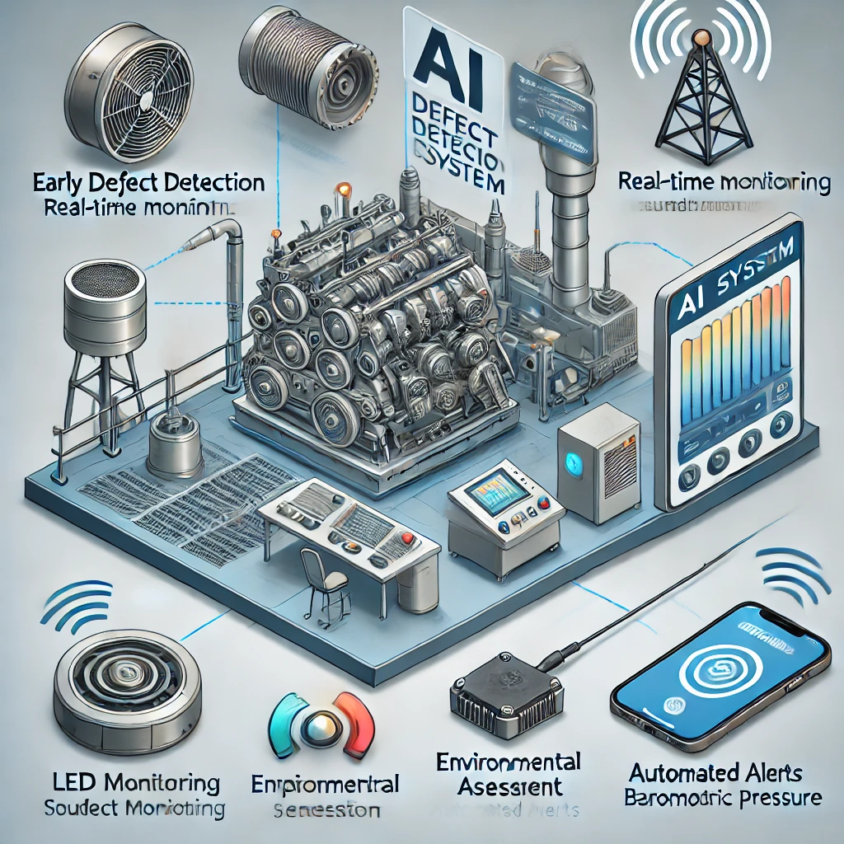
OBJECTIVE
Detect machine faults at an early stage by analyzing sound variations using a microphone and an AI model trained with Edge Impulse.
Enable remote motor control and real-time machine monitoring using ESP32 microcontrollers with ESP-NOW communication.
Monitor motor voltage continuously using a voltage divider circuit to detect abnormal electrical conditions.
Provide instant alerts using a buzzer when defective machine behavior is detected, enhancing maintenance response time.
Reduce unplanned downtime and maintenance costs through AI-powered predictive maintenance, improving operational efficiency and reliability.

Slide 5
Existing Systems & Their Main Drawbacks
Manual Inspection Systems – Time-consuming, prone to human error, and lacks real-time monitoring.
Vibration-Based Monitoring Systems – Limited to mechanical faults, requires frequent calibration, and cannot detect electrical issues.
Thermal Imaging Systems – Only detects overheating issues, expensive, and requires specialized training.
Oil Analysis Systems – Cannot provide real-time detection, requires lab testing, and is limited to lubricant-based components.
Basic Sound Monitoring Systems – Lacks AI-based analysis, cannot differentiate minor and major defects, and relies on predefined thresholds.

Slide 6

PROPOSED SYSTEM
AI-Based Sound Analysis – Utilizes a I2S microphone and AI model deployed via Edge Impulse to detect and classify motor sounds as either normal or defective for early fault detection.
ESP-NOW Communication & Control – Employs ESP32 modules for wireless control and communication. A microswitch on the transmitter triggers the relay on the receiver to start the motor.
Voltage and current Monitoring – Uses a voltage divider circuit to measure real-time motor voltage and current to detect abnormalities in electrical performance.
Automated Alerts & Notifications – Activates a buzzer for immediate local alerts when a defect is detected; can be extended to include mobile notifications.
Predictive Maintenance – Supports fault prediction and condition-based maintenance to reduce downtime, lower costs, and improve operational safety.
Cost Efficiency – Helps industries prevent failures, reduce downtime, lower maintenance costs, and improve workplace safety.

Slide 7
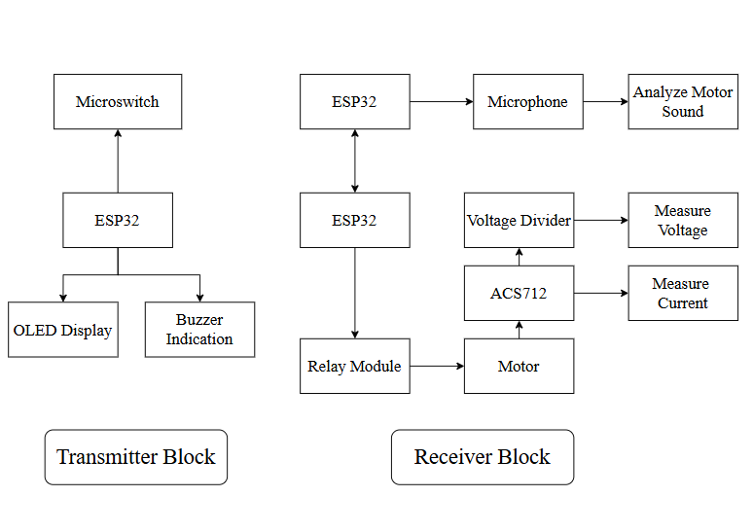
Block Diagram

Slide 8
FLOW CHART
Start
Micro Switch Pressed
Activates Relay Module
Motor Turns ON
Read Motor Voltage and current
Motor Sound Analyzes using Microphone
if
Defected?
No
Yes
Buzzer on
Stop

Slide 9
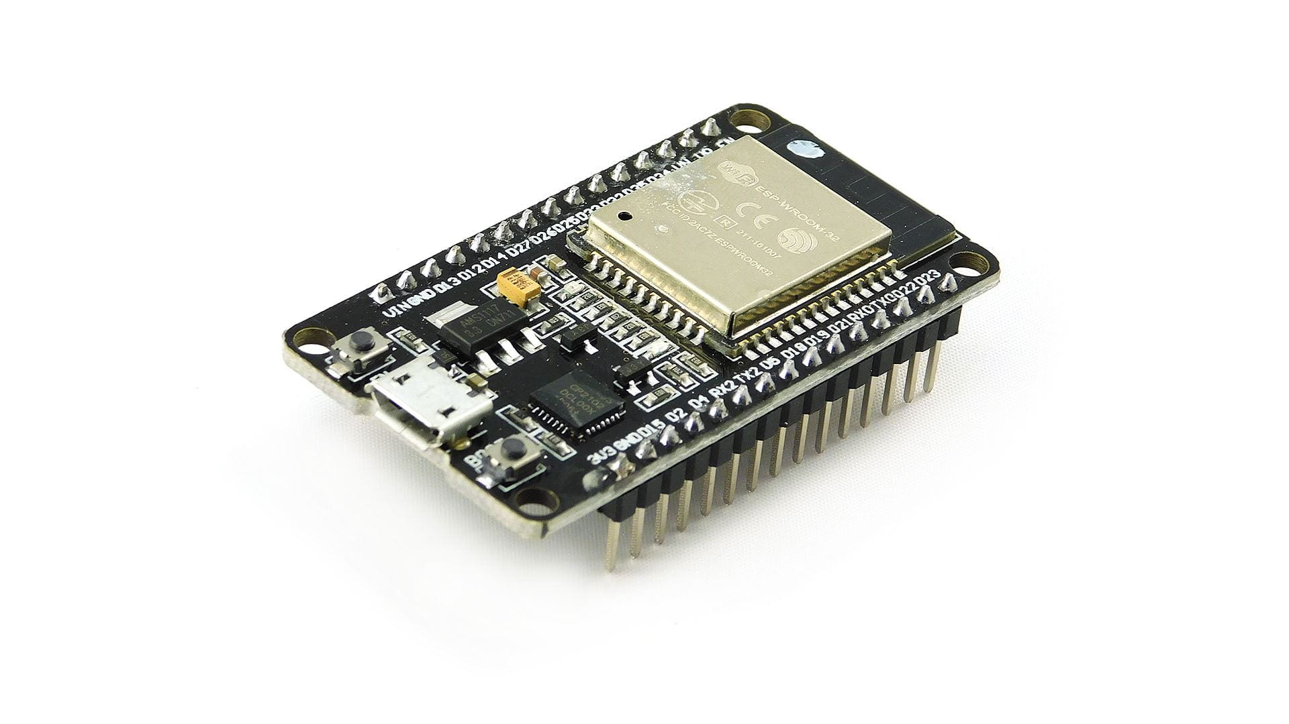
Hardware
ESP32 (Transmitter Block)
Function:
The ESP32 microcontroller in the transmitter block acts as the brain of the input system. It monitors the state of the microswitch and wirelessly sends that data to the receiver module using the ESP-NOW protocol—a fast and connectionless communication method ideal for IoT applications.
Role:
Continuously monitors the microswitch GPIO pin to detect user interaction.
When the microswitch is pressed, the ESP32 constructs a data packet and
transmits it to the paired receiver ESP32.
Ensures low-latency, low-power transmission to trigger immediate motor control on the receiving side.

Slide 10
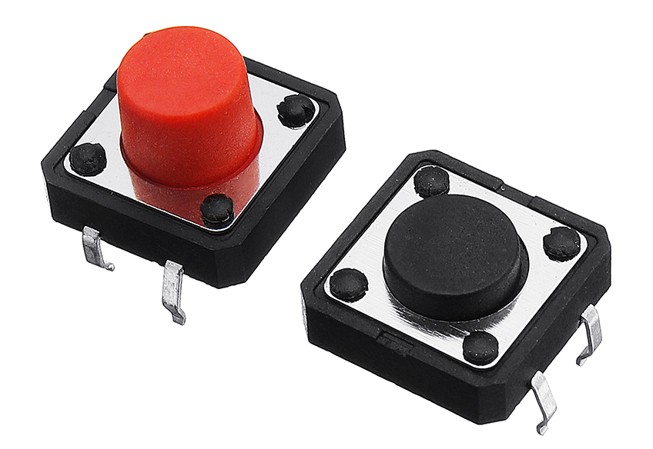
Hardware
Microswitch (Transmitter Block)
Function:
A mechanical switch that changes its state (open/closed) when pressed or released. It acts as a simple digital input to the ESP32.
Role:
Serves as the manual trigger for initiating the motor control process.
When the user presses the microswitch, it closes the circuit, signaling the ESP32 that an action (e.g., start motor) is required.
This signal is then sent wirelessly to the receiver unit for relay activation.

Slide 11
Hardware
ESP32 (Receiver Block)
Function:
The receiver ESP32 listens for ESP-NOW packets from the transmitter. Upon receiving a valid command, it activates connected actuators such as a relay to power on/off the motor.
Role:
Continuously operates in receive mode to capture incoming ESP-NOW data.
Decodes the received data to check if the relay should be triggered.
If the command is valid, it turns on or off the relay module connected to the motor's power supply.
Can also interact with other peripherals like a buzzer, LED, or voltage sensor for added system feedback.

Slide 12
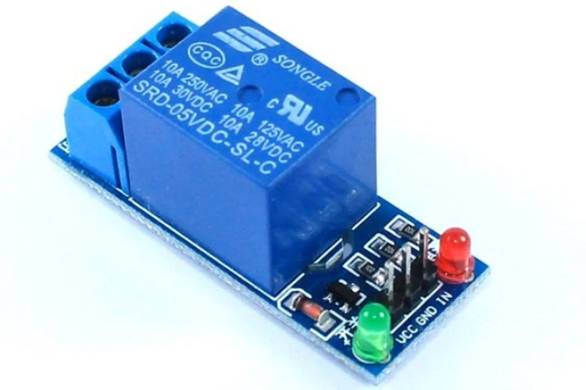
Hardware
Relay Module (Receiver Block)
Function:
The relay module acts as an electrically operated switch, allowing the low-power ESP32 signal to control a high-power device such as a motor.
Role:
Connected to the ESP32's digital output pin.
When triggered by the ESP32, the relay closes its circuit, allowing current to flow from the power supply to the motor.
This enables on-demand motor activation, making it suitable for remote or automated control applications.

Slide 13
It steps down higher voltages to safe levels suitable for analog-to-digital conversion by microcontrollers.
It steps down higher voltages to safe levels suitable for analog-to-digital conversion by microcontrollers.
Hardware
Voltage Divider Circuit (Receiver Block)
Function:
A resistor-based voltage divider circuit is used to measure the voltage of devices like motor and It steps down higher voltages to safe levels suitable for analog-to-digital conversion by microcontrollers.
Role:
Made using two resistors (R1 = 22kΩ and R2 = 10kΩ in your case).
Scales down the motor voltage proportionally.
The reduced voltage is fed into the ESP32’s analog input pin, allowing real-time voltage monitoring.
Useful for detecting abnormalities such as undervoltage, overvoltage, or motor startup spikes.

Slide 14
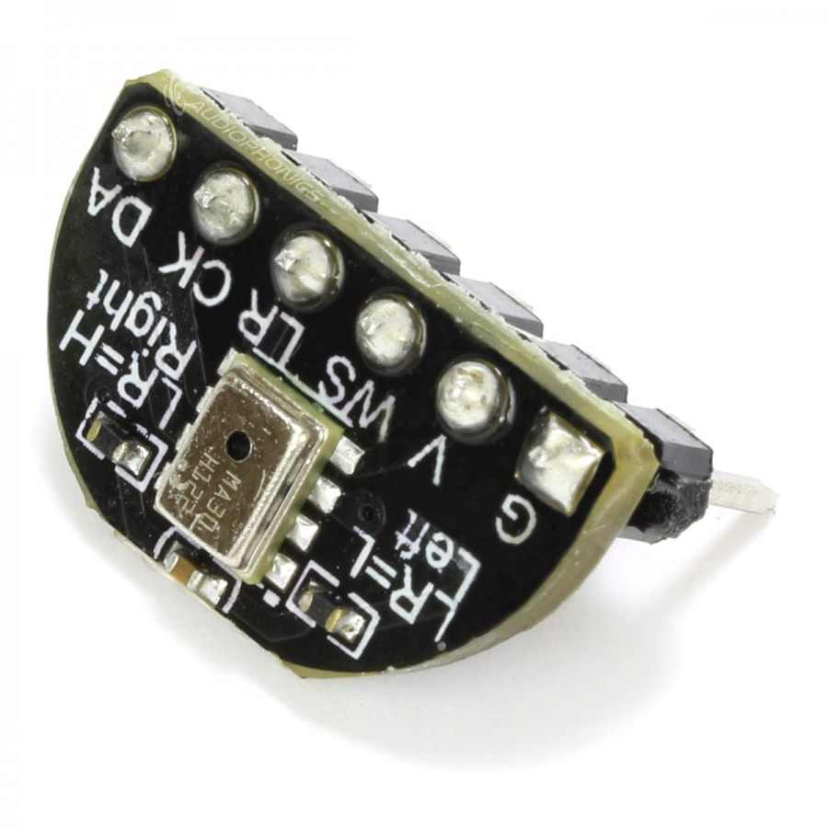
Hardware
I2S Microphone (Receiver Block )
Function: An I2S microphone is a type of digital microphone that sends sound data directly to a microcontroller (like ESP32) using a special communication method called I2S (Inter-IC Sound).
Role:
Captures motor-generated acoustic signals with low noise and high precision.
Sends real-time digital audio data via I²S interface to the ESP32.
The ESP32 processes this digital signal using an AI-based sound classification model (e.g., trained on Edge Impulse).
Helps classify the motor’s condition (normal or faulty), enhancing predictive maintenance capabilities and reducing downtime.

Slide 15
Software
Edge Impulse (AI Model for Motor Sound Classification)
Overview:
Edge Impulse is a machine learning development platform specifically designed for embedded and edge devices like the ESP32. It allows you to build, train, and deploy AI models that can run efficiently on microcontrollers.
How it is used in this project:
Data Collection:
Sound data from a motor (both normal and faulty) is collected using a microphone connected to the ESP32.
This data is uploaded to Edge Impulse for training the model.
Signal Processing:
Edge Impulse preprocesses the audio signals (converts them into spectrograms or MFCC features) to make it suitable for machine learning.

Slide 16
Software
Model Training:
A classification model is trained using the processed sound data to recognize patterns that indicate a normal or faulty motor.
Model Deployment:
The trained AI model is changed into a format that works with the ESP32 board, like a .h file or EON format. This model is added to the code on the receiver ESP32. Once uploaded, the ESP32 can check motor sounds and tell if they are normal or faulty in real time.
Real-Time Inference:
During operation, the microphone continuously listens to the motor sound.
The ESP32 runs the AI model locally and classifies the motor condition as either Normal or Faulty, without needing internet access..

Slide 17
^{Software}
Introduction to Arduino IDE
Arduino IDE (Integrated Development Environment) is an open-source software platform used for writing, compiling, and uploading code to microcontroller boards such as ESP32, Arduino UNO, and others. It is widely known for its simple and user-friendly interface, making it a popular choice for beginners and professionals in embedded systems and IoT development. The IDE supports programming in C/C++ and provides a wide range of built-in libraries and examples to simplify development.
Role of Arduino IDE in the Project
In this project, Arduino IDE is used to develop and upload the firmware for both the Transmitter and Receiver ESP32 boards. It serves as the central tool where all system logic is written, debugged, and deployed. From handling the microswitch input to controlling the relay, reading analog signals from the voltage divider, and running AI inference models — all programming is done within the Arduino IDE.

Slide 18
Software
Key Features Utilized in the Project
ESP32 Board Support
The Arduino IDE is configured with ESP32 board packages, allowing seamless programming and uploading of code to ESP32 microcontrollers via USB.
ESP-NOW Communication
Arduino IDE enables the integration of esp_now.h and WiFi.h libraries to set up wireless communication between the transmitter and receiver ESP32 modules.
Sensor and Actuator Handling
Code is written in the IDE to read the microswitch, measure voltage using the ADC, and control the relay that turns the motor ON/OFF.
AI Model Deployment
The Edge Impulse AI model, once trained, is converted into a C++ library and included in the Arduino sketch to perform on-device sound classification using the microphone input.
Serial Monitor for Debugging
The Serial Monitor in Arduino IDE helps in real-time debugging by displaying sensor readings, motor status, and AI predictions during testing and operation.

Slide 19
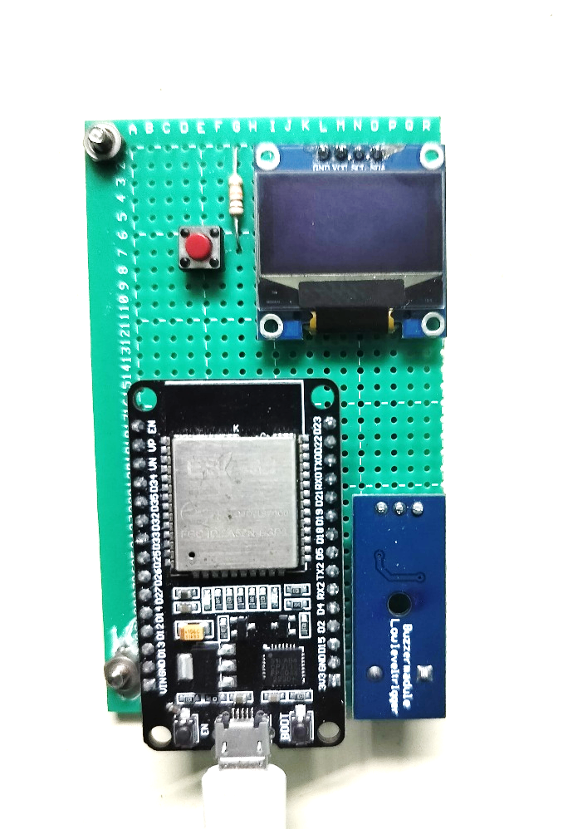
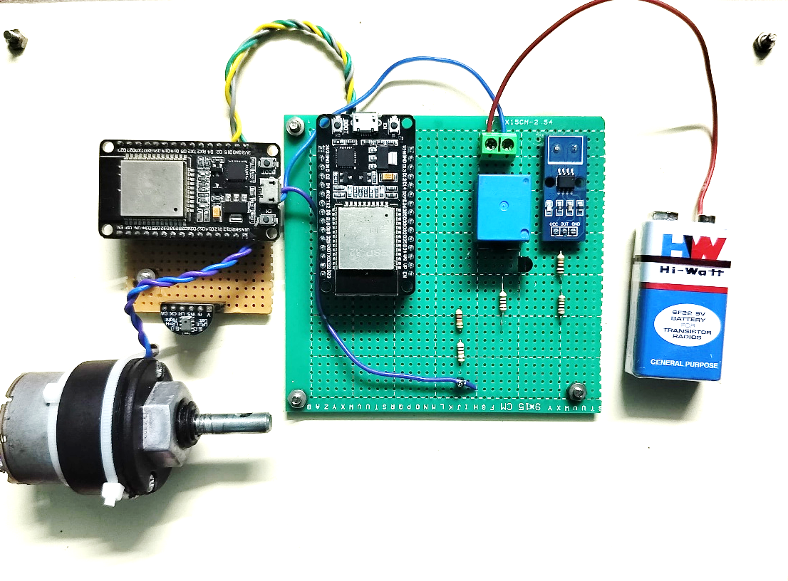
Hardware Setup:
Transmitter Block:
Receiver Block:

Slide 20
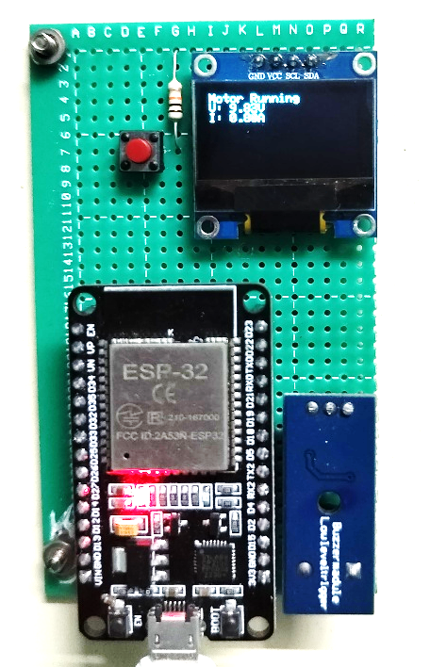
Output
In this case, the display shows "Motor Running", which means the motor is working properly. The voltage is 5.02V and the current is 0.52A, both of which are in the normal range. This tells us that the motor is getting the right amount of power and is running without any issues. The system checks the motor's condition using sensors and shows the result on the screen, helping users know everything is okay.

Slide 21
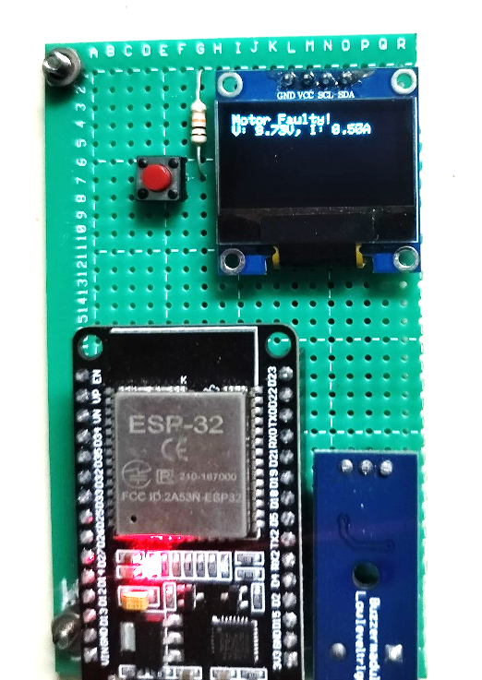
Output
In this case, the display shows "Motor Faulty!", which means something is wrong with the motor. The voltage is 5.70V and the current is 0.58A, which are higher than normal. This suggests there may be a problem like too much load or an electrical issue. The system detects this change and alerts the user by showing a fault message on the screen. This helps in finding and fixing problems early, before the motor gets damaged.

Slide 22
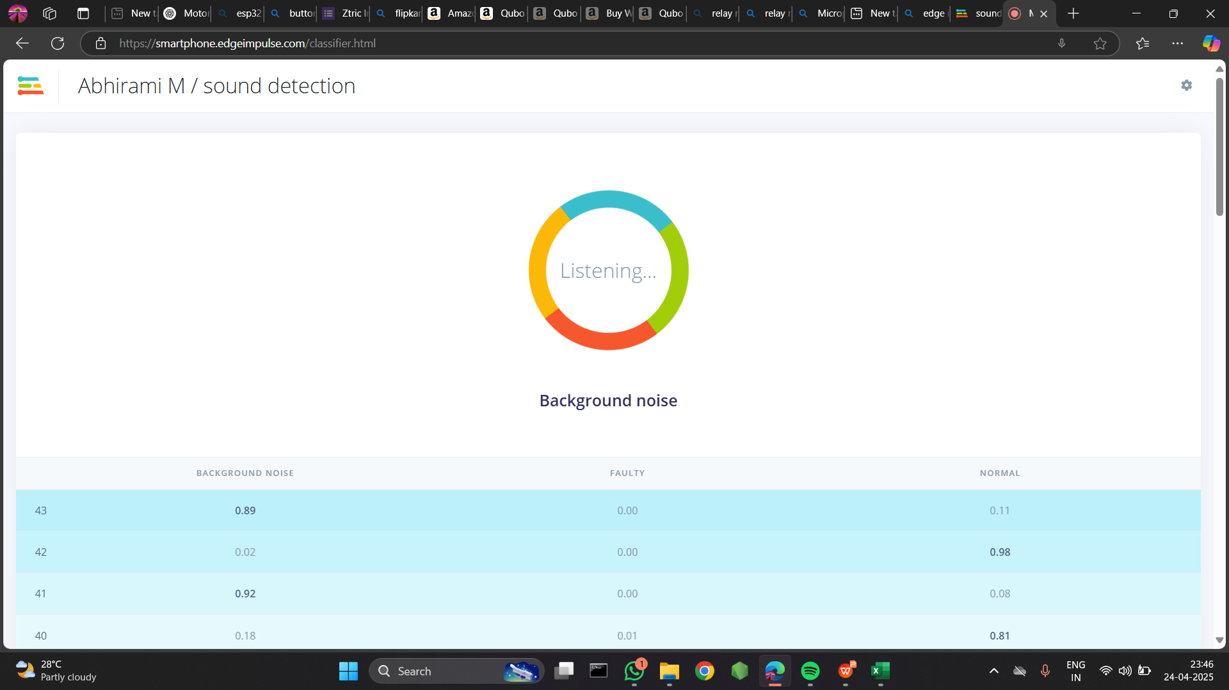
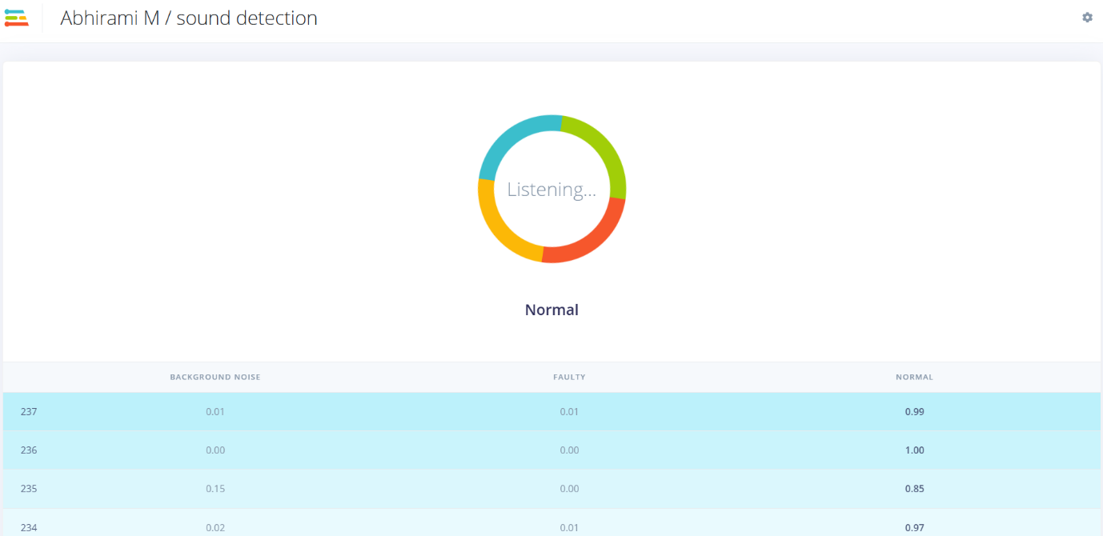
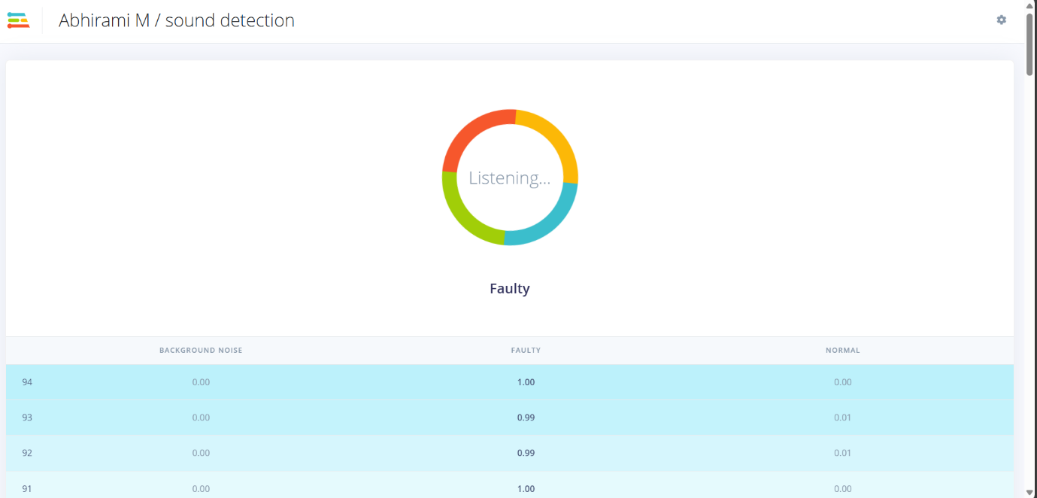
AI sound classificaion output
The visual output from the sound detection interface showcases the AI-based classification of motor sounds into three distinct categories: Normal, Faulty, and Background Noise. In this instance, the system is actively listening and has identified the predominant sound as Background Noise, with a high confidence score of 0.89. The classification confidence for Normal motor sound is 0.11, while Faulty sound registers 0.00, indicating no detection of motor fault during this sampling. This demonstrates that the AI model is functioning effectively, continuously analyzing incoming audio signals via the microphone and accurately classifying the motor condition in real time.

Slide 23


